Slide 1
A look at the Modern Principles
Bret Stateham
Technical Evangelist
Bret.Stateham@microsoft.com
BretStateham.com @BretStateham

Slide 2
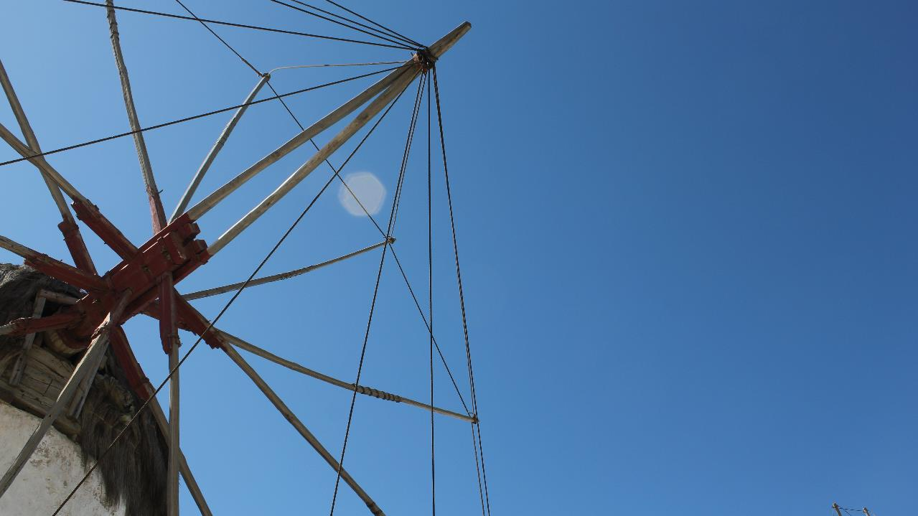
Modern Tenants
of Architecture
Notes:
This session will focus on what the modern principles are, and the steps needed to evolve a common on-premises system architecture to something that is more modern. We will discuss the tenants of modern architecture, and why they are important. For the whole discussion we will use a sample scenario. This session will walk through the current state of the system including an overview of the possible changes that can be made to update to a more modern style. Cost will be discussed as a factor in the decisions. One element to be discussed is the manual work needed, testing, risks of change, and how to get the most bang for the buck.
Photo credit: Brian H. Prince – The Windmills of Mykonos, Greece

Slide 3
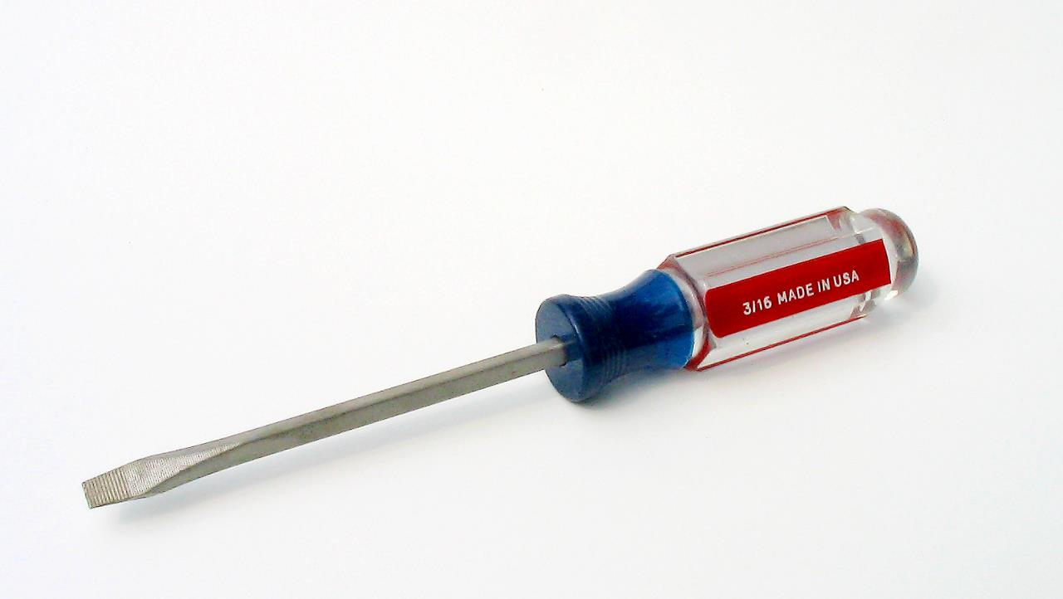
Open Standards

Slide 4

Leverage Frameworks
Only write the code that
only you
can write.

Slide 5

Services Based
Notes:
Commonly see REST at the edge of a enterprise connecting clients, and SOAP at the core connecting systems

Slide 6

Test it!

Slide 7

Dynamic & Virtual Infrastructure

Slide 8

Multi-tenant Architecture

Slide 9

BYOD

Slide 10
Multi-Client Architecture
Data Storage
Services (SOAP/REST)

Slide 11

Multi-Client Architecture
Photo Credit: Paul Underhill (link)

Slide 12
It’s not just about code…
There are many ways to enrich your application without having to write much code.
Notes:
Access to BIG IT, democratization, services services services
Bring in authentication from facebook, use something for global caching, global load balance, hadoop big data, etc.

Slide 13
Adopting the Cloud

Slide 14
Hybrid Architecture
http://img.blob.core.windows.net/images/brian.jpg
http://css.blob.core.windows.net/main.css
http://js.blob.core.windows.net/animations.js
Cloud
Blob Container
Bandwidth
CSS
Images
JS
On-premises
http://www.myco.com/images/brian.jpg
Bandwidth
db
CSS/Images/JS
HTML
Application
Notes:
Hybrid, enrichment, etc.

Slide 15
Hybrid Architecture
jpg
css
js
aspx
html
Azure
On-Premises
jpg
css
js
aspx
html

Slide 16
Lift & Shift
Build Virtual Machine in the Cloud
Lowers upload time and dependency risk
Requires upload and installation of application and data
Migrating an Existing Virtual Machine
Application, Configuration and Data in an installed Working State
Requires uploading a large amount of data and a higher risk of drivers or other hardware dependencies on VM not available in the cloud
Notes:
Best when moving an existing app, brownfield.
Slide Objective:
There are essentially two ways of migrating an application to the cloud.
Notes:
The first is to attempt to migrate an entire existing virtual machine. For Hyper-V users this involves uploading the VHD(s) and then configuring a virtual machine to use the disks.
For non-Hyper-V users this means finding a method of converting either their running machine to a VHD OR their current virtualization format to VHD. Many solutions exist to both.
The second option comes down to configuring and booting the VM in the cloud directly. Uploading the application and data via Windows Azure storage and configuring the VMs.

Slide 17
Migrating a Multi-VM Application
Cloud Service Acts as a Networking Boundary
All VMs in the same service can communicate directly
Name resolution between VMs is automatic with Windows Azure provided DNS
Cloud Service
Name: myapp1.cloudapp.net
Load Balancer
Public IP
Virtual Machine
VM Name: iisvm1
10.1.5.6
Virtual Machine
VM Name: iisvm2
10.1.5.7
DIP
DIP
DIP
Virtual Machine
VM Name: sqlvm1
10.1.5.8
Notes:
Slide Objective:
In the Windows Azure management portal there are two methods of creating a VM.
Notes:
Quick create always creates a new cloud service but it does not display the cloud service. Each time this wizard is used a cloud service with a single VM will be created.
Gallery method gives the option of creating a Stand Alone VM or the option to Connect to an existing VM.
Stand alone VM gives similar behavior to Quick Create. A new cloud service will be created with the new VM being the sole occupant.
Connect to an existing VM allows you to add a single VM to an existing cloud service.
All VMs within the same cloud service can directly communicate with each other over the network. If they are not deployed inside of a virtual network they will also have name resolution by default with Windows Azure provided DNS. If deployed into a VNET the requirement is shifted to the user to provide name resolution.

Slide 18
Virtual Machine Migration
Windows Azure Supports VHD File Format
Other formats will have to be converted or migrated before upload
Upload Existing VHDs using PS (Add-AzureVHD)
Supports Resuming Failed Transfers
Converting from Dynamic to Fixed Disk on Upload
Efficient Upload – does not send empty bytes
Things to Do Before Uploading OS Disk
Enable Remote Access
Notes:
Slide Objective:
Explain nuances of migrating VMs
Notes:
Dynamic Disks are not supported directly in the cloud. Before uploading a dynamic disk it will have to be converted into a fixed disk.

Slide 19
Migrating a Simple Virtual Machine
Migration Steps
1) Upload VHDs
Azure PS or other Tools Add-AzureVHD
2) Create VM Configuration
with data disks attached Data Disk 1 = APP-Data.vhd
Data Disk 2 = App-Logs.vhd
New-AzureVMConfig
3) Create VM
New-AzureVM
4) Adjust App for Drive Letters
5) Add Endpoint(s)
80, TCP, http
443, TCP, https
Cloud Service
Name: myapp1.cloudapp.net
On-Premises Virtual Machine
Machine Name: APPSRV1
Memory: 8 GB
Cores: 4
Ports: 80/443 for http/https
Deployment
Slot Production
Virtual Machine
Role Name: appsrv1
4 Cores
7 GB Ram
Guest: C:\
Host: C:\VMs\APP-OS.vhd
Windows Azure
Storage
TCP Endpoints 80 and 443
Guest: D:\
Host: D:\VMs\APP-Data.vhd
Guest: C:\
WAStorage\VMs\APP-OS.vhd
Guest: E:\
Host: E:\VMs\APP-Logs.vhd
Guest: E:\
WAStorage\VMs\APP-Data.vhd
Guest: F:\
WAStorageVMs\APP-Logs.vhd
Notes:
Slide Objective:
This animation is a simple example of the steps needed to migrate a VM running in Hyper-V on premises to Windows Azure.
Notes:
The reason for the adjustment in drive letters is the Windows Azure VM exposes the local server physical storage as the D: drive on Windows. This location should be considered temporary because it is not backed by Windows Azure storage. Since the D: is taken VMs that are currently using the D: drive will need to be adjusted on upload.

Slide 20
Stay to the Right

Slide 21



IaaS
PaaS
SaaS
Infrastructure-as-a-Service
Platform-as-a-Service
Software-as-a-Service
host
build
consume
More Control
More Freedom

Slide 22

The Benefits of PaaS
PaaS is faster
Reason: There’s less work for developers to do
Benefit: Applications can go from idea to availability more quickly
PaaS is cheaper
Reason: There’s less admin and management work to do
Benefit: Organizations spend less supporting applications
PaaS is lower risk
Reason: The platform does more, leaving fewer opportunities for error
Benefit: Creating and running applications gets more reliable
Notes:
Slide Objective:
Explain benefits of a PaaS Model

Slide 23
Connecting the Cloud to the Real world

Slide 24
Common Connectivity Scenarios
App Servers connecting to local data
Nightly backups
Integrated Authentication
Frontend servers connecting to backend servers
Connect remote management tools
And many more

Slide 25
Windows Azure Virtual Network
Persistent IP Address Requirements
Virtual Machines deployed into a virtual network have an infinite DHCP lease
Hybrid On-Premises Cloud Apps
Requirement for connectivity between your data center and the public cloud
Connectivity between cloud services
Deploying Active Directory in the Cloud or connecting a PaaS to IaaS Service
Corpnet
Windows Azure
VM 1
VM 2
Subnet 1
Subnet 2
ROLE 1
Notes:
Slide Objective:
Quick reference of use cases for VNET
Notes:
Windows Azure Virtual Networks provide functionality above and beyond site to site networking.
VNETs also provide persistent IP addresses through an infinite DHCP lease (not static but effectively the same thing).
VNETs also provide the capability of connecting cloud services in the same affinity group directly. This allows for scenarios like web and worker roles to virtual machines running services like SQL Server 2012 or SharePoint.

Slide 26

Connecting Applications and VMs
Strengths
Simplicity
Tenant Autonomy
VIP Swap (cloud services)
Easy Local Dev/Test
Load Balancer
SQL Data Access Traffic Through Public Endpoint
80
Cloud Service or Web Site
Weaknesses
Higher Latency
Less Secure Management/Deployment Overhead
Secure Endpoints with Windows Server Firewall
Cloud
Service
2001-1433
SQL Server
Load Balancer
Notes:
Slide Objective:
Connecting cloud services without a VNet
Notes:
This diagram illustrates how you can configure applications such as Windows Azure Web Sites or Cloud Services to connect to applications running on virtual machines without directly putting them on the same virtual network. Note currently Windows Azure Web Sites do not support virtual networks.
The application on the VM will need to have an endpoint opened on it to allow inbound traffic from the other service.
To secure connections it is recommended the firewall on the VM be configured to restrict traffic only from the service.

Slide 27
Connecting Cloud Services with VNET
Strengths
Protect VMs from the open Internet
Lower Latency
VIP Swap (web / worker roles)
Advanced Connectivity Requirements
ContosoVNet (10.0.0.0/8)
Cloud
Service1
80
AppSubnet
(10.0.0.0/16)
Load Balancer
Web or Worker
Weaknesses
VNET Complexity
Windows Azure Provided DNS does not span cloud services
Direct Access via VNET
Cloud
Service 2
SQLSubnet
(10.1.0.0/16)
AD
AD Subnet
(10.2.0.0/16)
SQL Mirror
Notes:
Slide Objective:
Connecting cloud services with a VNET
Notes:
In this scenario a web/worker role is deployed on the same virtual network as the virtual machines.
The benefit is direct connectivity without the need for configuring endpoints on the load balancer.
This is a requirement for scenarios like AD that require persistent IP addresses or lots of ports (RPC/COM+).

Slide 28
DEMO
Connecting Cloud Services
Notes:
Slide Objective:
DEMO
Notes:
See DEMO-ConnectingCloudServices

Slide 29
A simple scenario

Slide 30
Customers
in field
Can’t Scale with Load
Single Network Point
Each customer’s datacenter
On-premises datacenter
Web
Server
(4 core VM)
Single Point of failure
Customer SQL
SQL
Server
(4 cores VM)
Customer SQL
Backup and Mgmnt
Customer SQL
Notes:
Go over details, and workload, talk about flaws. They worried about system going down and stopping their customers from working

Slide 31
Scenario #1: Lift and Shift
Customers
in field
Simple to migrate
Can easily scale vertically
Still managing all infrastructure
Easy to come back if not happy
Each customer’s datacenter
Windows Azure
Web
Server
(4 core VM)
Customer SQL
Two Large (four core) servers:
$460.80 / month
Storage of VHDs for the servers (~50GB)
$4.75 / month
Storage txs for VHDs (~10 million)
$1.00 / month
Total: About $466.55 / month
SQL
Server
(4 cores VM)
Customer SQL
Customer SQL

Slide 32
Scenario #2: Lift and SQL Database
Customers
in field
Simple to migrate
Migrate data to SQL Database
Can easily scale vertically
Still managing server infrastructure
Easy to come back if not happy
Each customer’s datacenter
Windows Azure
Web
Server
(4 core VM)
Customer SQL
One Large (four core) server:
$230.40 / month
Storage of VHDs for the server (~25GB)
$2.38 / month
Storage txs for VHD (~5 million)
$0.50 / month
SQL Database – 10GB
$45.96 / month
Total: About $279.23 / month
Customer SQL
SQL
db
Customer SQL

Slide 33
Scenario #3: Cloud Services
Customers
in field
More work to migrate code
Can easily scale horizontally
99% no management of servers
Auto-scaling by load through day
Each customer’s datacenter
Windows Azure
Web
Role
Web
Role
Customer SQL
Four small (single core) servers
$230.40 / month
SQL Database – 10GB
$45.96 / month
Total: About $276.36 / month
Web
Role
Web
Role
Customer SQL
SQL
db
Customer SQL
Notes:
While a lot of money can be saved by scaling down at low times, our estimates are fixed to four full time units/cores to make comparison easy

Slide 34
Scenario #4: Mobile Services
Customers
in field
More work to migrate code, data
Simple data models only
Can easily scale horizontally
No management of servers
Auto-scaling by load through day
Auto creates REST façade on data
Native client data SDKs
Have to update app
Each customer’s datacenter
Windows Azure
API
API
Customer SQL
API
API
Four units
$100.00 / month
SQL Database – 10GB
$45.96 / month
Total: About $145.96 / month
Customer SQL
SQL
db
Customer SQL

Slide 35
Which way would you go?
Lift & Shift
Lift with SQL Database
Move to Cloud Services
Ride the Unicorn with Mobile Services
Easy to start
Still easy, bit of work
Need to move code, but less management
Significant work
Far less management
Notes:
They chose #3. Cost savings, easy scaling. Were willing to invest up front, vs a little to lift and shift, and re-invest months later to move again. Wanted to move once. Their data model was too complex for the unicorns, and their api was more than just a data façade.

Slide 36
HANDS-ON LAB
01-SetupVS2013SQLVM Create a development Virtual Machine
02-AzureStorageLab
Move an On-Premises Web Site’s Assets to Windows Azure Storage
03-MigratingDatabaseToSQLDatabae
Migrate an On-Premises SQL Server Database to a Windows Azure SQL Database
03-MigratingDBtoSQLVM
Migrate an On-Premises SQL Server Database to a Windows Azure VM with SQL Server
04-MigratingAWebSiteToWindowsAzureWebSite
Move an On-Premises Web Site to a Windows Azure Web Site
Notes:
Slide Objective:
DEMO
Notes:
Essentially this is quick run through of the hands on lab, minus unit testing and load testing
Create a TFS project
Create a Windows Azure Web Site
Link the Web Site to the TFS Project
Use VS to update the Web Site and check in
Show continuous deployment in TFS and Windows Azure management portals

